Slide 1
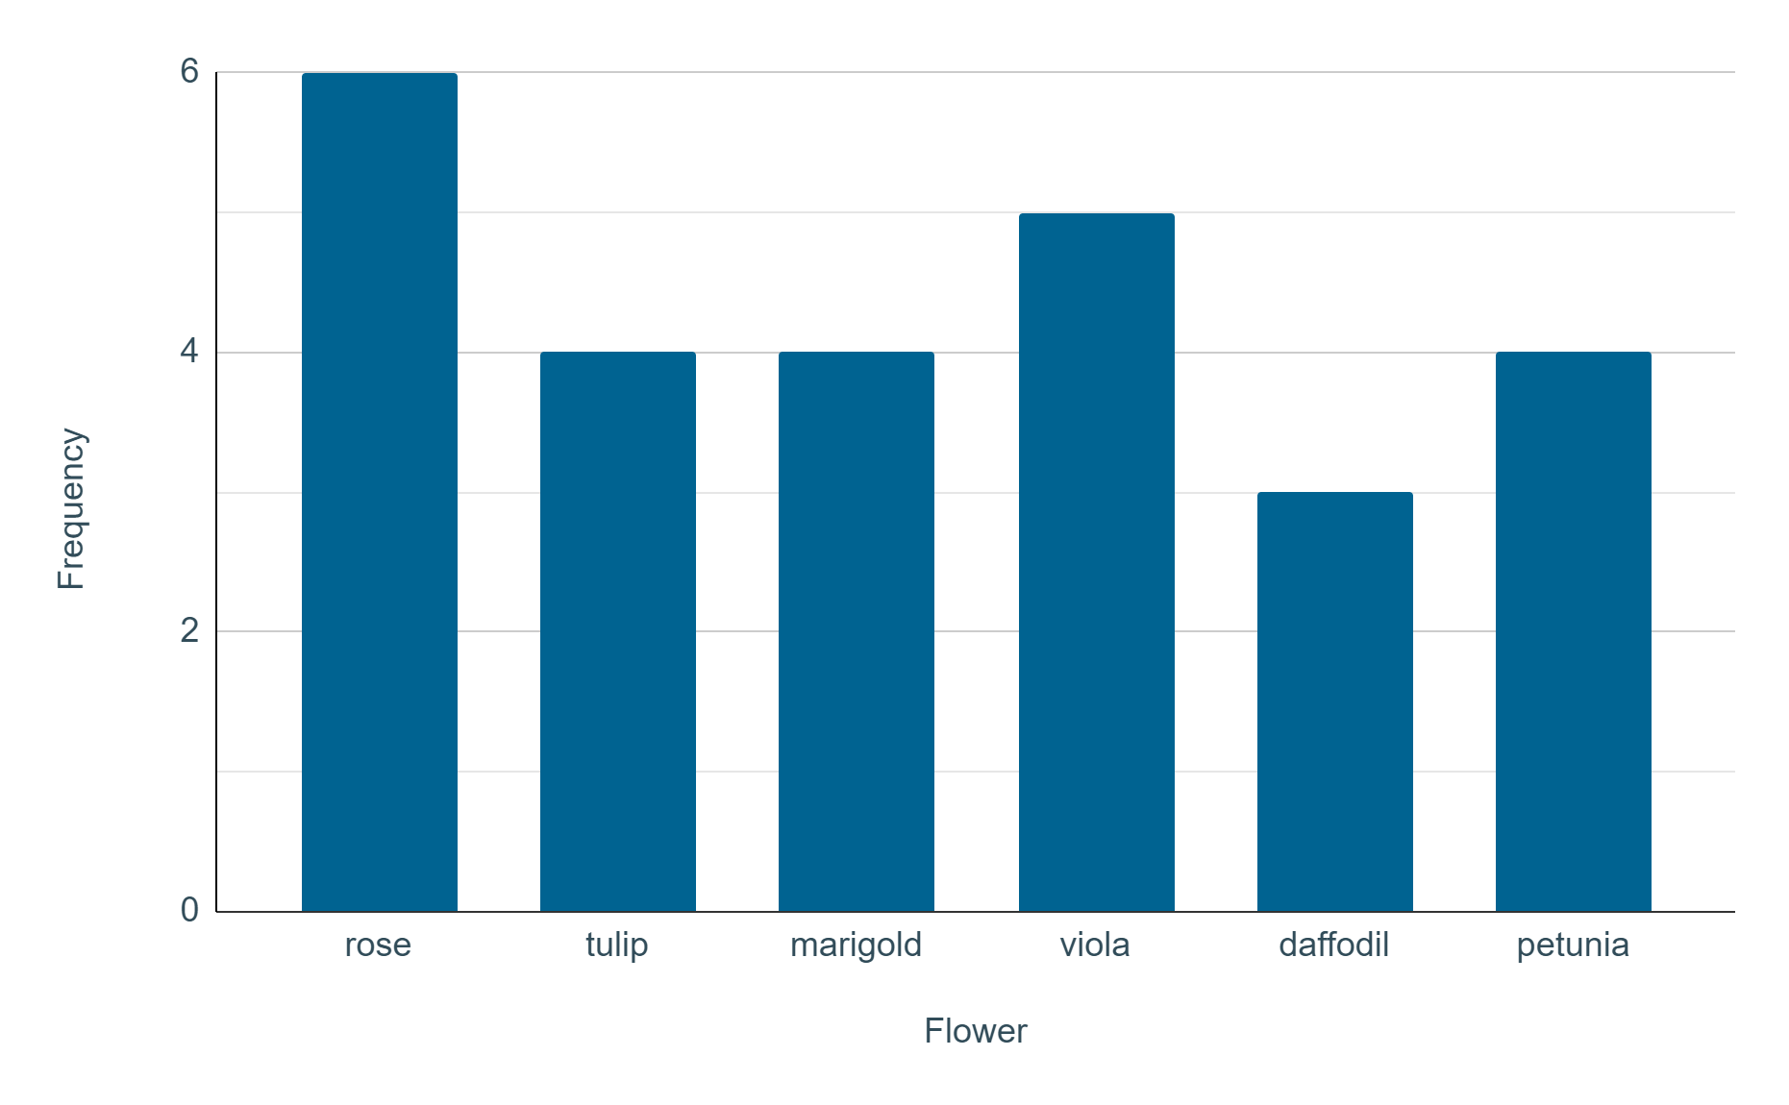
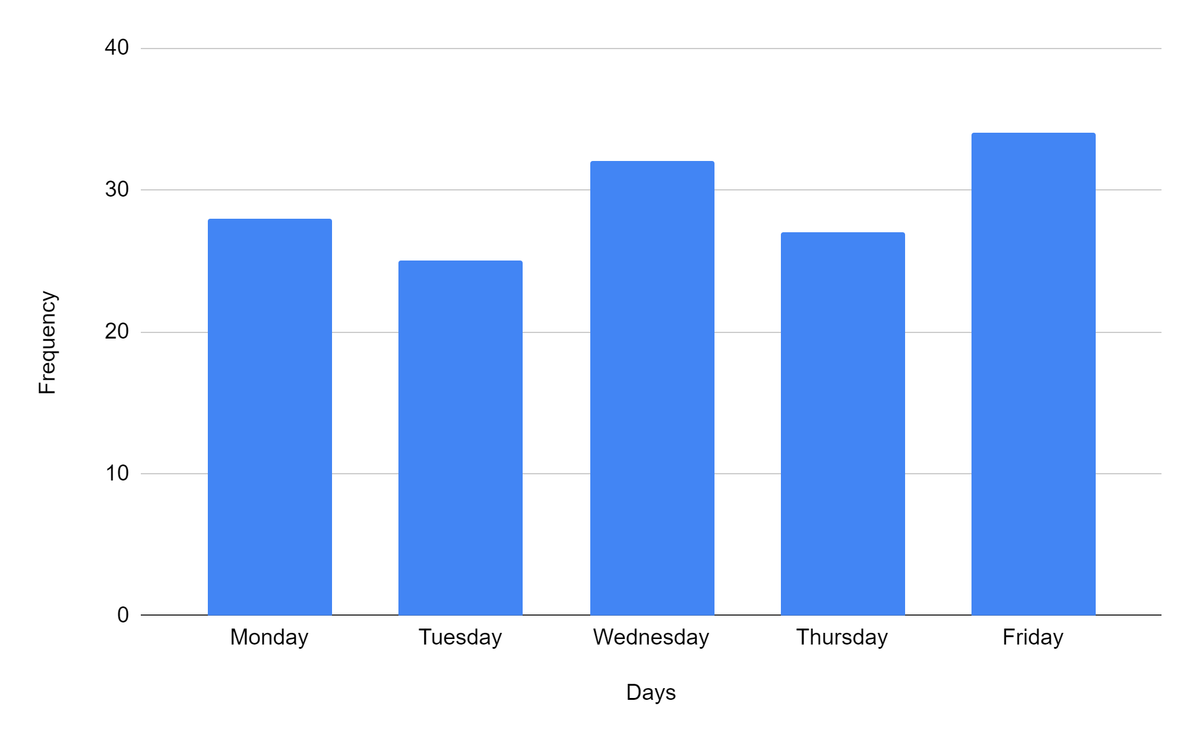
Constructing bar charts by utilising technology
Task A: Creating bar charts on spreadsheet software
The flower sales at a garden centre are recorded.
Create a bar chart for this list of data: rose, tulip, marigold, viola, rose, rose, marigold, viola, daffodil, tulip, daffodil, petunia, marigold, daffodil, rose, tulip, petunia, petunia, tulip, marigold, rose, viola, rose, petunia, viola, viola Ensure it has a title on both axes.
Would you advise the garden centre to order an equal amount of each flower next time or different amounts? Explain your answer.
It doesn’t matter if you have changed the colours or scales.
Your response may have included:
The total amount of sales is not very high, so although daffodil sales were the lowest on this particular day, it may not be the case on another day. The garden centre should collect further data to get a better understanding of the sales.
Create a bar chart for this table of data about visitors to a museum.
Day of the week | Frequency
Monday | 28
Tuesday | 25
Wednesday | 32
Thursday | 27
Friday | 34
Google Sheets is a trademark of Google LLC and this content is not endorsed by or affiliated with Google in any way.

Slide 2
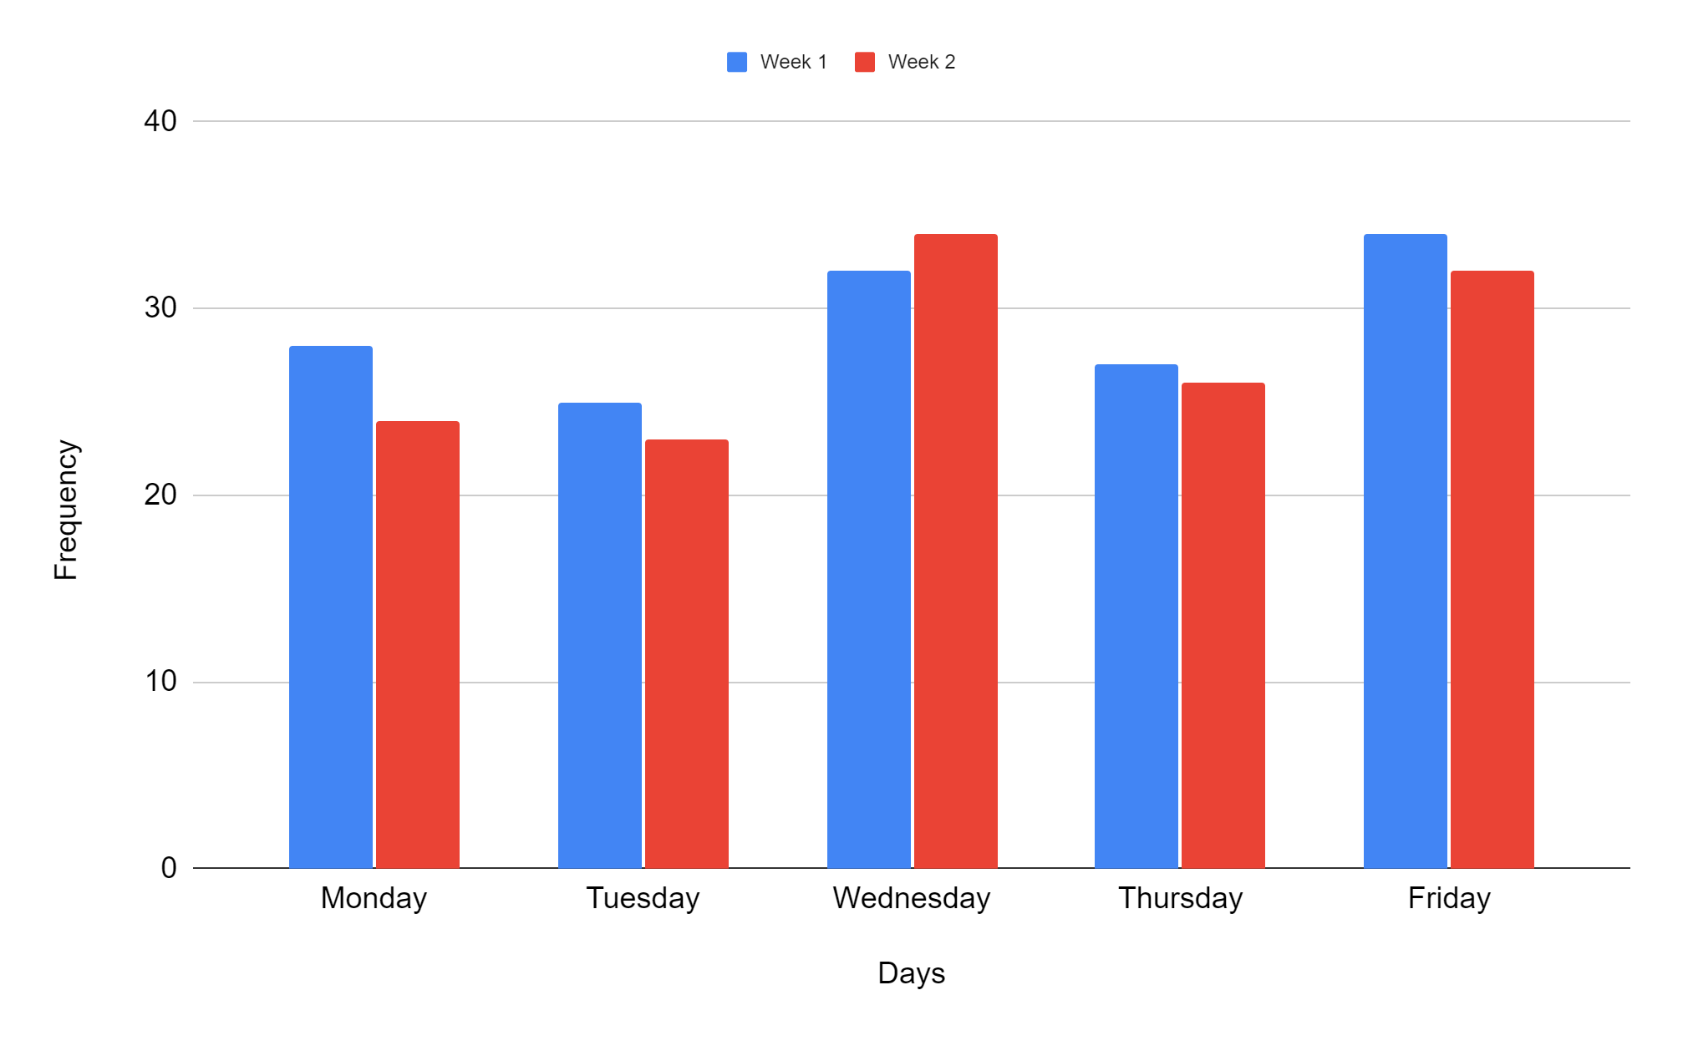
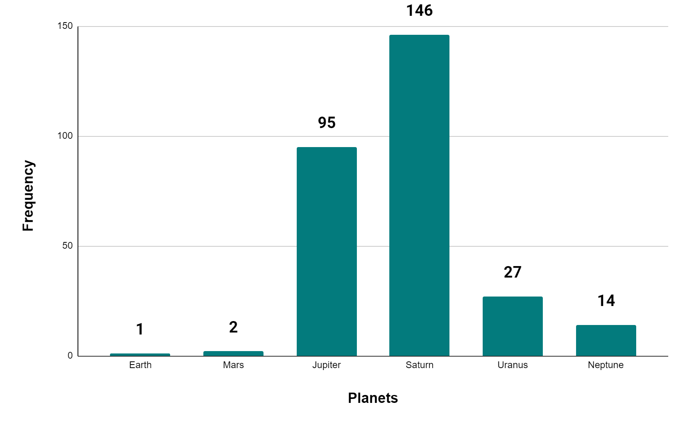
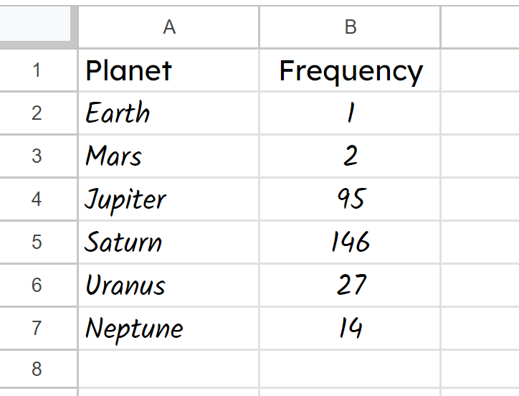
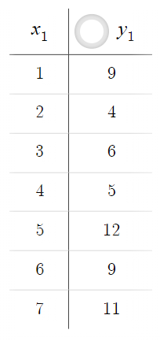
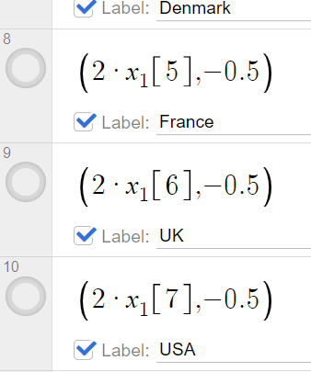
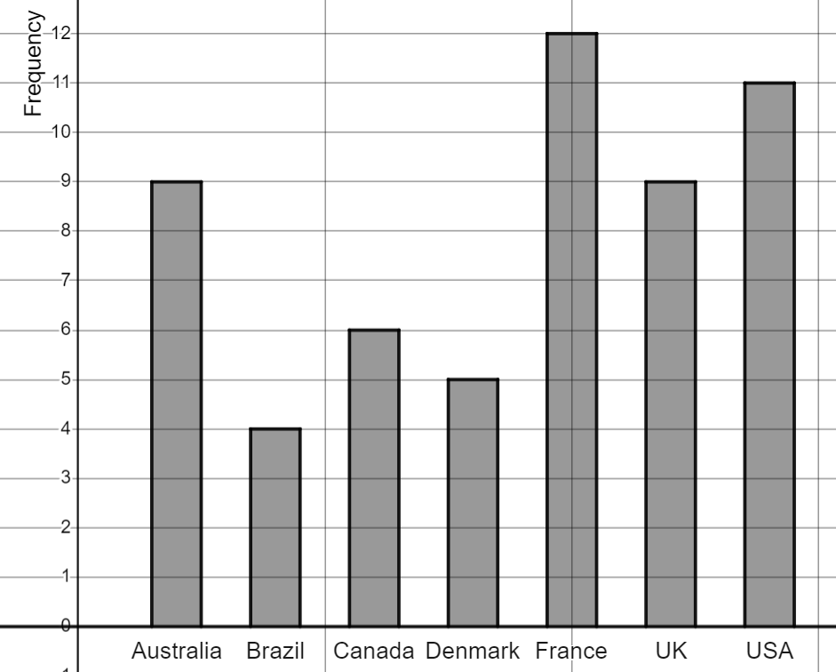
Constructing bar charts by utilising technology
Create a bar chart for this table of data about visitors to a museum.
What is different about this bar chart?
It is a comparison bar chart, as there were two sets of data for the same thing.
Task B: Creating bar charts using a template file
Using the Template file 🖇 recreate this bar chart.
The data should have been added like this.
Task B Question 2 🖇 recreate this bar chart showing the number of time zones per country (including overseas territories).
Mathematics in Education and Industry.
Google Sheets is a trademark of Google LLC and this content is not endorsed by or affiliated with Google in any way.
v2.2

